Slide 1
Information and Communication Technologies – Basic Terms
Ing. Simona Kubíková, PhD.
Department of Road and Urban Transport
University of Žilina
Žilina, Slovakia

Slide 2
What Does Information Mean?
Data
Information
Knowledge
Information leads to an increase in understanding and decrease in uncertainty.
Information is valuable because it can affect behavior, a decision, or an outcome.

Slide 3
Information System
Collecting data
Storing data
Processing data
Distributing data
Information system also includes people, technical means and methods which ensure collecting, processing and storing data for presenting this information to users.

Slide 4
Elements of Information System
Software – suitable information system, apps and security
Hardware – computers, printers, cameras, etc.
Peopleware – employees, external users
Orgware – legislature, laws
Dataware – sources of data and information, databases

Slide 5
Structure of Information System
Collecting data: measuring (sensors and detectors, meteo-stations,...); verbal (police, public, drivers); databases (restrictions, public transport)
Processing data: dispatch centres, centres of traffic information
Distributing data: provide individually (GSM,WAP), available for public (radio, RDS/TMC, variable message signs)
Collecting data
Information transfer
Distributing data
Processing data

Slide 6
Information Systems in Road Transport
Static – one direction process of information, f.e. radio broadcasting, RDS/TMC, GSM
Dynamic – both direction process of information, where a vehicle provides information about its position. A centre of transport information can provide information to this vehicle directly; it is short range transfer
Source of information
Processing system
Source of information
Processing system

Slide 7
Information Systems in Road Transport
Acoustic and optic – radio broadcasting, navigation, VMS
Whole traffic flow – VMS
Inside a vehicle – RDS/TMC, navigation

Slide 8
Information Systems in Road Transport
Important characteristics of information:
Real time
Valuable
Credible
Accurate
Drivers' willingness to accept provided information is crucial!!

Slide 9
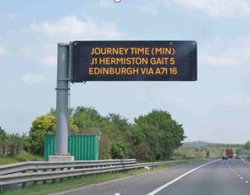
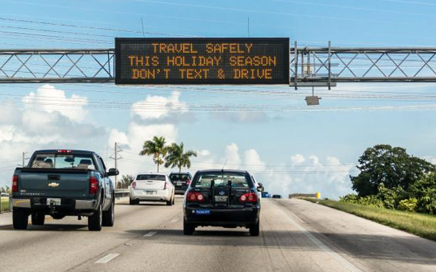
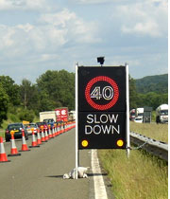
Traffic Flow Information Systems
Information is provided by information boards near a road or by portal over a road (variable message signs).
Information about traffic accidents, congestions, obstacles on roads, delays, bad weather conditions, tunnel closures, etc.

Slide 10
Traffic Flow Information Systems
Information is automatically generated in NTIC
Critical parameters are intensity and speed of traffic flow
Bi-directional communication is needed
Control unit has continuous power source which provides information transfer about defects and system's failures
Communication is provided by metal or optical line
GSM/SMS and radio connection

Slide 11
Information Systems in Vehicles
1. Vehicle works as a ,,floating vehicle“
which sends information about its position.
Providing information via radio transmission.
Vehicle should be equipped with an on-board unit

Slide 12
Information Systems in Vehicles
Active information system
Vehicle sends information about its position to the control centre.
Control centre sends relevant information about traffic situation, congestions, restrictions, etc., within the driver' s chosen route
Communication between a vehicle and a centre is ensured f.e. by DSRC

Slide 13
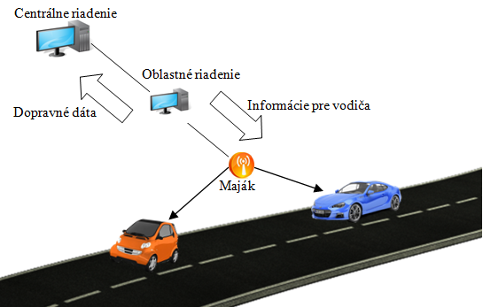
Information Systems in Vehicles
Active Information System
Central management
Local management
Information for driver
Traffic Data
Transmitter

Slide 14
Information Systems in Vehicles
Passive Information System
One-way communication
Vehicle does not send information about its position
Vehicle only receives information about traffic situation from traffic centre
GSM, RDS/TMC

Slide 15
Information Systems in Vehicles
Real - Time Information about Traffic Accidents
Choose an alternative route
Avoid traffic accident, congestions and delays
Modern trends – electronic recorder of accident (30 sec before TA and 15 sec after); recording speed, acceleration, direction and characteristics of vehicle

Slide 16
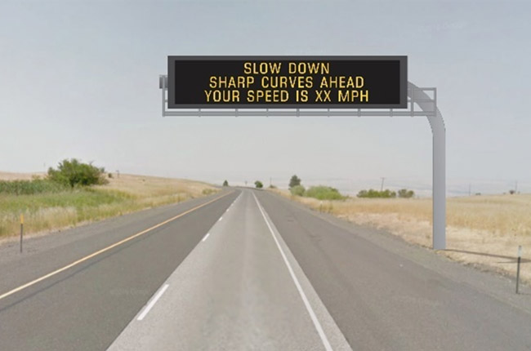
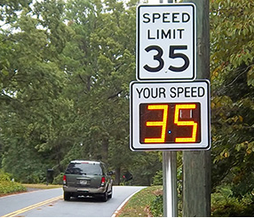
Information Systems in Vehicles
Real - Time Information about speed and occurrence of danger
Traffic sensors and detectors measuring speed (radars)
VMS – sharp curve, dangerous intersection
Main goal - decrease a number of traffic accidents caused by high speed and breach of traffic regulations

Slide 17
Information Systems in Road Transport
Benefits:
Increasing traffic safety,
Reducing uncertainty in decision making – traffic situation
Decreasing time delays
Effective using of road communication network
Reducing drivers' stress behaviour
Reducing negative impacts on environmental
Accident cost savings
Operating cost savings

Slide 18
National System of Transport Information
Basic requirements for NSTI implementation:
Increase mobility and quality of transport services
Minimizing congestions
Increase effectiveness of transportation
Provide real time information to road users
Reduce emissions and fuel consumption
Increase quality of life and environment
The main aim of NSTI is to ensure better traffic flow fluency and traffic safety.

Slide 19
National System of Transport Information
includes National Traffic Information Centre
Central, technological, operational and organising part of NSTI
ensures collecting, confirming, processing, and providing traffic information
Providing information – telecommunication channels, RDS/TMC, web pages, etc.
Gathering information from road users, police, owner and administrator of road network, administrator of fee collection, meteorological stations, etc.

Slide 20
National System of Transport Information

Slide 21
Communication Systems in Road Transport
Transfer of information and providing to road users, using telecommunication networks
Fixed communication networks – wireless and wired networks
Mobile communication networks – satellite and ground systems
Requirements for safety, reliability and availability of information transmission
No requirements
Any environment
Requirements
Special networks

Slide 22
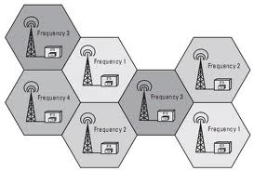
Communication Systems in Road Transport
GSM (Global System for Mobil Communication)
First standard GSM published in 1990
Area divided to cells with different frequencies
Multiple using of assigned frequencies – follow the rule of distances between each cells which use the same frequency

Slide 23
Communication Systems in Road Transport
GSM (Global System for Mobil Communication)
Driver sends an SMS with his route on a predefined telephone number and in a moment he receives information about traffic situation.
Possible to use GSM for vehicle tracking in real time but only if GPS is available.

Slide 24
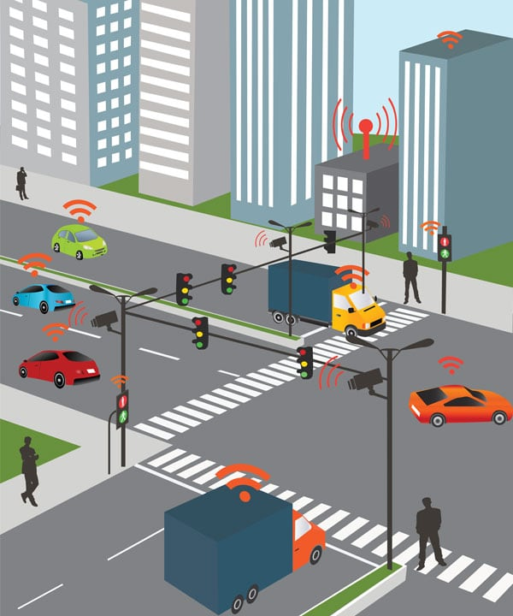
Communication Systems in Road Transport
DSRC (Dedicated Short Range Communication)
Wireless system based on microwaves or infra-red transmission
Transmission for short ranges
High resistance of bad weather conditions
Using within active safety (avoidance of traffic accidents occurrence, ambient sensing, communication V2V and V2I)

Slide 25
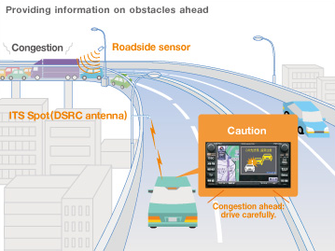
Communication Systems in Road Transport
DSRC (Dedicated Short Range Communication)
System of emergency warning of vehicles in front
Adaptive cruise control
Cooperative caution of collision in front of a vehicle
Caution of complicated junction
Controlling of vehicle safety
Electronic payment for parking
Electronic fee collection
Railway crossing warning

Slide 26
Communication Systems in Road Transport
RDS/TMC (Radio Data System/ Traffic Message Channel)
RDS
Communication protocol standard for embedding small amounts of digital information in conventional FM radio broadcasts
Digital information are showed on radio display
TMC
Specific application of FM RDS used for broadcasting real-time traffic and weather information.
Data messages are received silently and decoded by a TMC-equipped navigation system, and delivered to the driver
Offering dynamic route guidance – alerting the driver of a problem on the planned route and calculating an alternative route to avoid the incident

Slide 27
Communication Systems in Road Transport
TMC
Standard TMC user messages provide five basic items of broadcast information: event description, location, direction and extent, expected duration, diversion advice
Benefits:
Updated traffic information, delivered in real time
Instant knowledge of accidents, roadworks and traffic jams
Filtered information only for the immediate route
Information in user’s own language
High-quality digital transmission
Standardised compatibility of receivers
Widespread service delivery

Slide 28
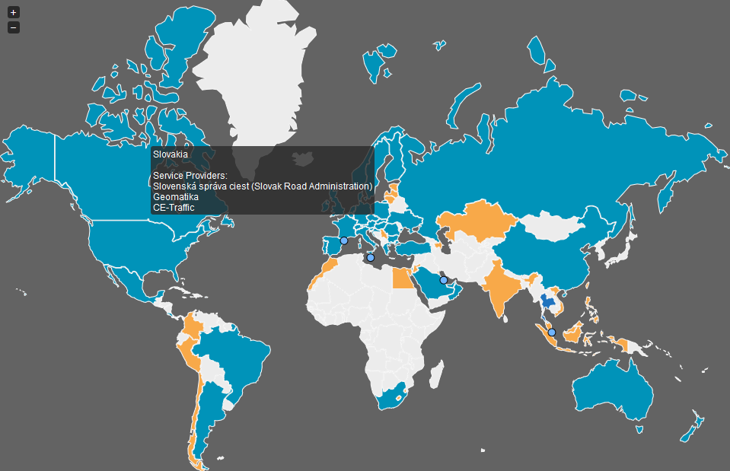
Communication Systems in Road Transport

Slide 29
Communication Systems in Road Transport
TPEG (Transport Protocol Experts Group)
offer a method for transmitting multimodal traffic and travel information, regardless of client type, location or required delivery channel (e.g. DAB, HD radio, Internet, DVB-x, DMB, GPRS, Wi-Fi) and it is language independent.
TPEG applications:
Road Traffic Message (RTM)
Public Transport Information (PTI)
Traffic Event Compact (TEC)
Traffic Flow and Prediction (TFP)
Parking Information (PKI)
Weather Information (WEA)
Congestion and Travel Time (CTT)

Slide 30
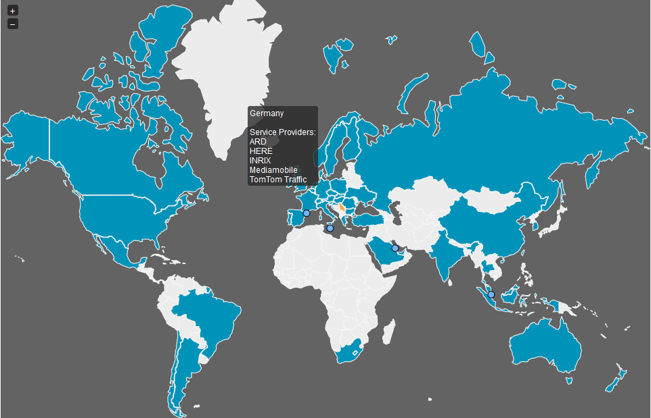
Communication Systems in Road Transport

Slide 31
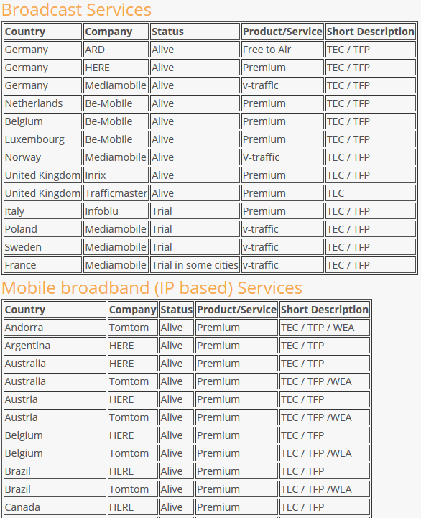

Slide 32
Variable message signs
https://www.youtube.com/watch?v=KsRvAIoLd-s
https://www.youtube.com/watch?v=LeqjFHbZ0J4
https://www.youtube.com/watch?v=WCECCoQzY5o
RDS -TMC
https://www.youtube.com/watch?v=PLKh_tLWdlI
https://www.youtube.com/watch?v=cPalrA2DeTg
https://www.youtube.com/watch?v=24tgONHEbSM HERE traffic

Slide 33
Thank you for your attention.
Simona.Kubikova@fpedas.uniza.sk
Department of Road and Urban Transport
University of Žilina
Žilina, Slovakia

